Slide 1
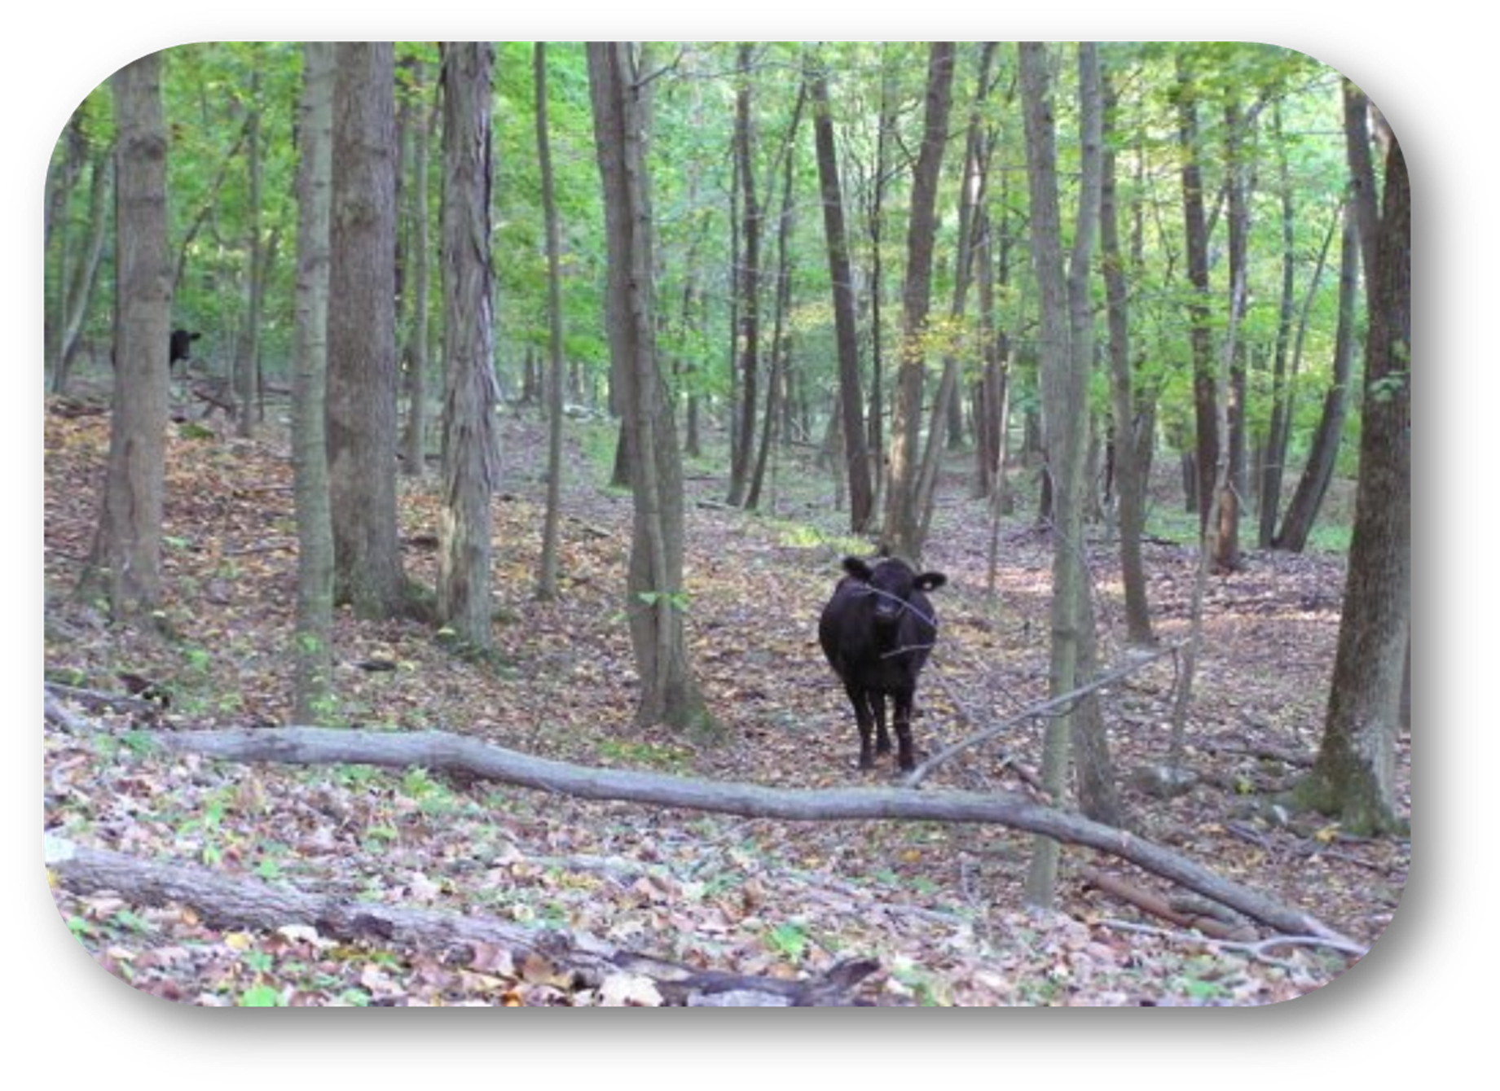
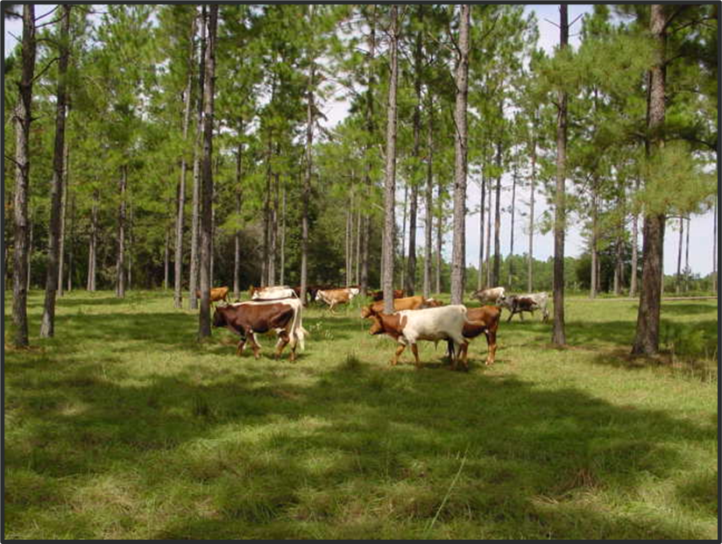

Module 10: Soil Health Considerations when Grazing Forestlands

Slide 2
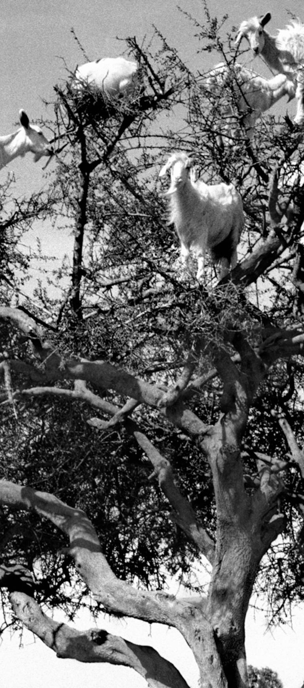
Overview
Livestock in the woods
Managed forest grazing
Silvopasture
Alfredo Caliz, National Geographic, Panos Pictures
Notes:
Image source: National Geographic, photograph by Alfredo Caliz, Panos Pictures

Slide 3
Forest Soil Health
Maximize Soil Cover
Minimize Disturbance
Maximize Continuous Living Roots
Maximize Biodiversity
Notes:
Image source: https://kaiserscience.wordpress.com/earth-science/surface-processes/soil-profile/
To briefly review, our FSH assessment tool keys in on soil cover, soil disturbance, soil structure/compaction, and living roots. An additional piece to consider is overall forest ecosystem health. Forest farming systems that are part of a healthy forest ecosystem probably exhibit good forest soil health, based on site limitations. Forest farming systems that introduce new plants or that alter the site conditions extensively are likely moving away from healthy forest soils.
The introduction of livestock into an existing forest system can have negative effects on forest soils and forest ecosystems. Let

Slide 4









Forest Soil Health
Soil Cover
Minimize Disturbance
Living Roots
Biodiversity
Forest Ecosystem Health
Notes:
Image source: https://kaiserscience.wordpress.com/earth-science/surface-processes/soil-profile/
To briefly review, our FSH assessment tool keys in on soil cover, soil disturbance, soil structure/compaction, and living roots. An additional piece to consider is overall forest ecosystem health. Forest farming systems that are part of a healthy forest ecosystem probably exhibit good forest soil health, based on site limitations. Forest farming systems that introduce new plants or that alter the site conditions extensively are likely moving away from healthy forest soils.
The introduction of livestock into an existing forest system can have negative effects on forest soils and forest ecosystems. Let

Slide 5
Forest Soil Health
Soil Cover * Aggregate Stability
Minimize Disturbance * Compaction
Living Roots * Soil Organic Matter
Biodiversity * Soil Organism Habitat
Forest Ecosystem Health * Plant Structure and Composition
Notes:
Image source: https://kaiserscience.wordpress.com/earth-science/surface-processes/soil-profile/
To briefly review, our FSH assessment tool keys in on soil cover, soil disturbance, soil structure/compaction, and living roots. An additional piece to consider is overall forest ecosystem health. Forest farming systems that are part of a healthy forest ecosystem probably exhibit good forest soil health, based on site limitations. Forest farming systems that introduce new plants or that alter the site conditions extensively are likely moving away from healthy forest soils.
The introduction of livestock into an existing forest system can have negative effects on forest soils and forest ecosystems. Let

Slide 6
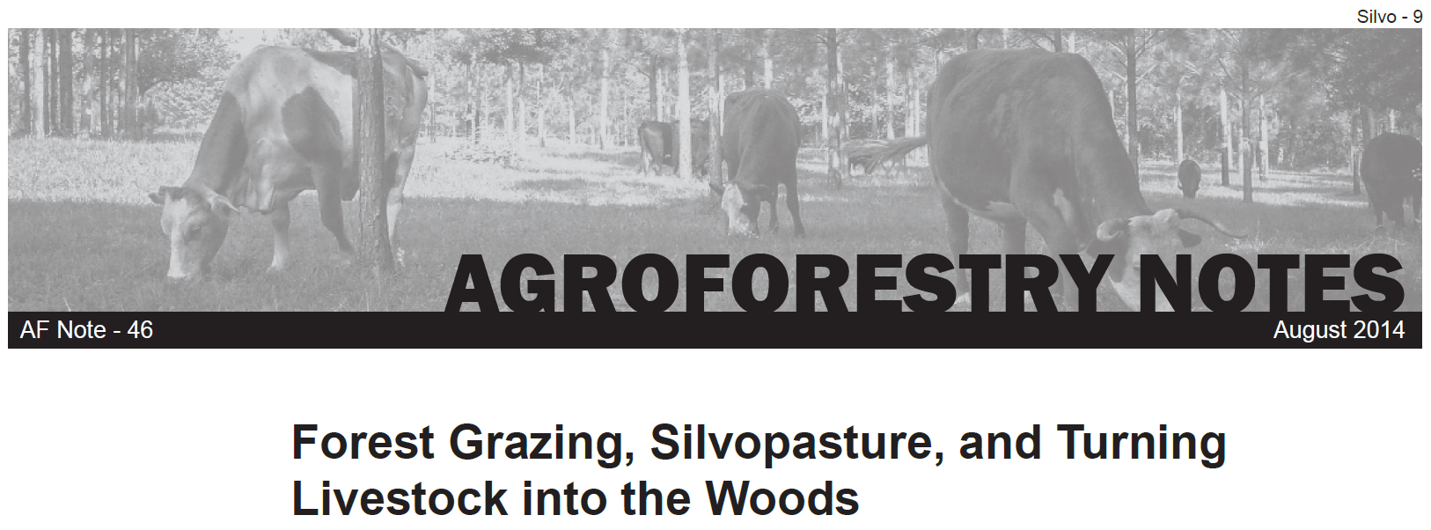
Three Scenarios
  Turning Livestock into the Woods
  Forest Grazing
  Silvopasture
https://www.fs.usda.gov/nac/assets/documents/agroforestrynotes/an46si09.pdf
Notes:
Authored by Syd Brantley, NRCS National Grazing Specialist

Slide 7
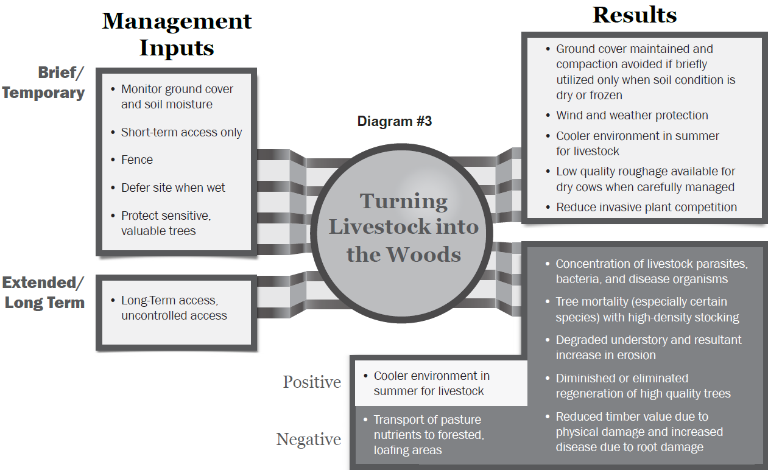
Notes:
“Turning Livestock into the Woods (as depicted in Diagram #3) is usually based on the need for additional forage or browse, to rest other pastures and sometimes just the need to reduce environmental stress on animals. … However, when a relatively large number of cattle have uncontrolled access to forest for long periods of time, timber production and forest attributes will almost always degrade”.

Slide 8


Notes:
“Turning Livestock into the Woods (as depicted in Diagram #3) is usually based on the need for additional forage or browse, to rest other pastures and sometimes just the need to reduce environmental stress on animals. … However, when a relatively large number of cattle have uncontrolled access to forest for long periods of time, timber production and forest attributes will almost always degrade”.

Slide 9
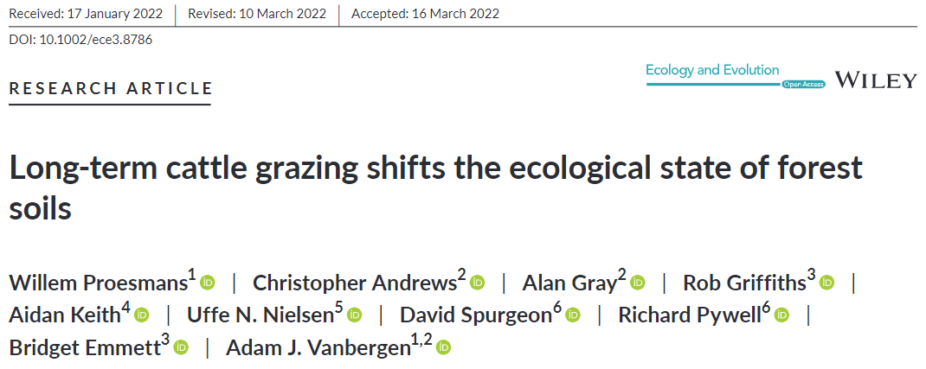
https://doi.org/10.1002/ece3.8786
Notes:
This study looked specifically at cattle-grazed birch forests in Scotland with a median grazing period of 30 years vs birch forests that had not been grazed in 70-100 yrs.

Slide 10
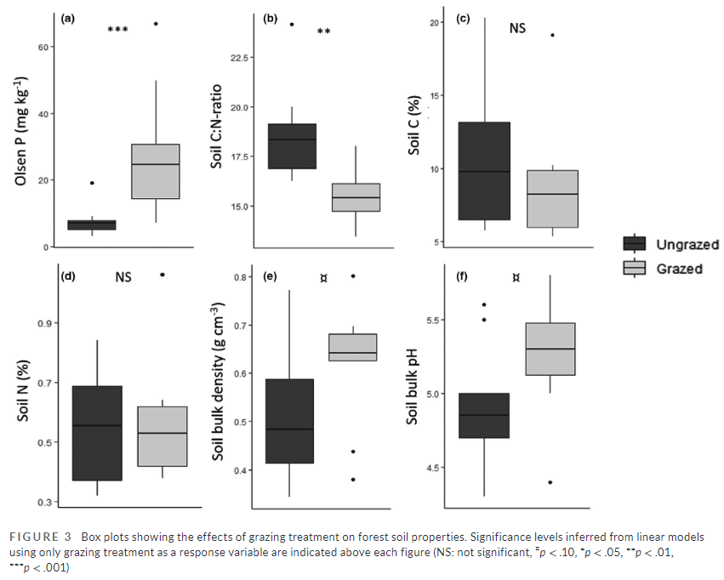
https://doi.org/10.1002/ece3.8786
Notes:
This study looked specifically at cattle-grazed birch forests in Scotland with a median grazing period of 30 years vs birch forests that had not been grazed in 70-100 yrs.

Slide 11






https://doi.org/10.1002/ece3.8786
Notes:
This study looked specifically at cattle-grazed birch forests in Scotland with a median grazing period of 30 years vs birch forests that had not been grazed in 70-100 yrs.
Highlighted items are significance levels for “p” value. The lower the p-value, the greater the statistical significance of the observed difference.
(p-value is the probability of obtaining results as extreme as, or more extreme than the observed results, assuming the null hypothesis is true)

Slide 12
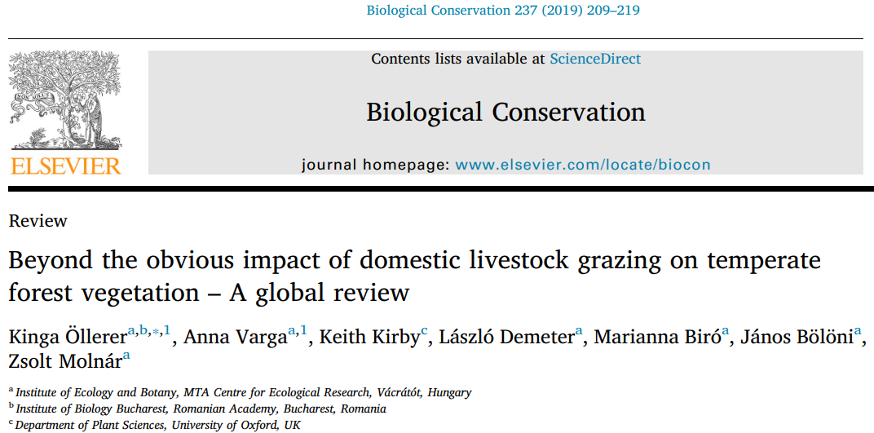

Slide 13
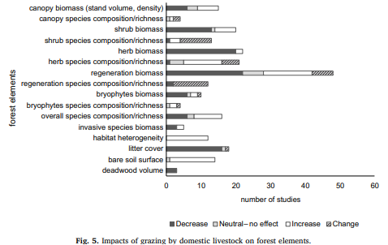
https://doi.org/10.1016/j.biocon.2019.07.007
Notes:
Beyond the obvious impact of domestic livestock grazing on temperate forest vegetation – A global review
Kinga Öllerer, Anna Varga, Keith Kirby, László Demeter, Marianna Biró, János Bölöni, Zsolt Molnár.
Biological Conservation Volume 237 , September 2019, Pages 209-219
Bare soil surface ↗ Trampling and uprooting removes dead and live plant materials from forest floor, leading to an increase in bare soil cover
Litter cover ↘ Trampling and grazing reduce the thickness of the herb and regeneration layer. In a less dense herb layer wind removes litter more easily. Grazed forests have lower litter depth and cover
Abundance of ground-growing bryophytes ↗ Heavy grazing reduces the competition from vascular plants and accumulation of litter from vascular plant and trees.
Grass cover, especially of grazing-adapted species ↗ Increasing light and reducing tall or competitive palatable species (e.g. Hyacinthoides non-scripta). In combination with active canopy management, cattle grazing can reduce shrub cover, favouring higher quality grass cover when forage production is a goal
Reduces the total biomass of the herb layer ↘ Grazing can decrease the competitive dominance of the herbaceous layer, significantly reducing sward biomass. Sheep can be very effective in removing grass phytomass.
Abundance of palatable species decreases and abundance of unpalatable species increases ↘ ↗ Selective forage and diverse palatability of herb layer species (e.g. high forage value plants are often good winter forage, like Hedera helix). Grazing has a negative impact on the palatable Hyacinthoides non-scripta. The abundance and/or frequency of species highly preferred by cattle, like Fagus orientalis seedlings or Vicia crocea is reduced

Slide 14
https://doi.org/10.1016/j.biocon.2019.07.007
Notes:
Beyond the obvious impact of domestic livestock grazing on temperate forest vegetation – A global review
Kinga Öllerer, Anna Varga, Keith Kirby, László Demeter, Marianna Biró, János Bölöni, Zsolt Molnár.
Biological Conservation Volume 237 , September 2019, Pages 209-219
Bare soil surface ↗ Trampling and uprooting removes dead and live plant materials from forest floor, leading to an increase in bare soil cover
Litter cover ↘ Trampling and grazing reduce the thickness of the herb and regeneration layer. In a less dense herb layer wind removes litter more easily. Grazed forests have lower litter depth and cover
Abundance of ground-growing bryophytes ↗ Heavy grazing reduces the competition from vascular plants and accumulation of litter from vascular plant and trees.
Grass cover, especially of grazing-adapted species ↗ Increasing light and reducing tall or competitive palatable species (e.g. Hyacinthoides non-scripta). In combination with active canopy management, cattle grazing can reduce shrub cover, favouring higher quality grass cover when forage production is a goal
Reduces the total biomass of the herb layer ↘ Grazing can decrease the competitive dominance of the herbaceous layer, significantly reducing sward biomass. Sheep can be very effective in removing grass phytomass.
Abundance of palatable species decreases and abundance of unpalatable species increases ↘ ↗ Selective forage and diverse palatability of herb layer species (e.g. high forage value plants are often good winter forage, like Hedera helix). Grazing has a negative impact on the palatable Hyacinthoides non-scripta. The abundance and/or frequency of species highly preferred by cattle, like Fagus orientalis seedlings or Vicia crocea is reduced

Slide 15
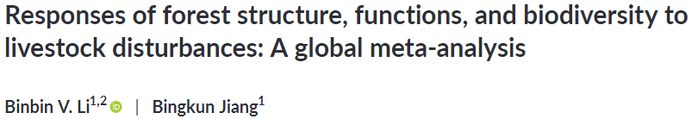

https://onlinelibrary.wiley.com/doi/epdf/10.1111/gcb.15781
Notes:
Li, B. V., & Jiang, B. (2021).Responses of forest structure, functions, and biodiversity tolivestock disturbances: A global meta-analysis. Global ChangeBiology, 27, 4745–4757. https://doi.org/10.1111/gcb.15781

Slide 16
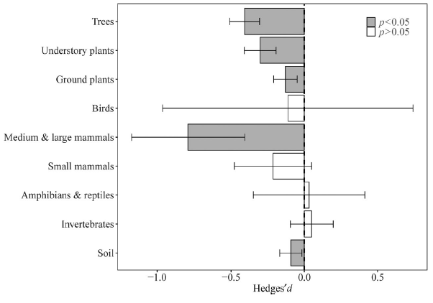
Notes:
F I G U R E 2 Mean effect sizes (Hedges’ d) of livestock effects on different groups in the forest ecosystem. Significant
effect (p < 0.05) is denoted by gray color. Error bars stand for bias-corrected 95% bootstrap confidence intervals
Note: Hedges’ d statistical model is based on inferential statistics which allows for analysis from a sample to make conclusions about a larger population.

Slide 17

Notes:
F I G U R E 2 Mean effect sizes (Hedges’ d) of livestock effects on different groups in the forest ecosystem. Significant
effect (p < 0.05) is denoted by gray color. Error bars stand for bias-corrected 95% bootstrap confidence intervals
Note: Hedges’ d statistical model is based on inferential statistics which allows for analysis from a sample to make conclusions about a larger population.

Slide 18
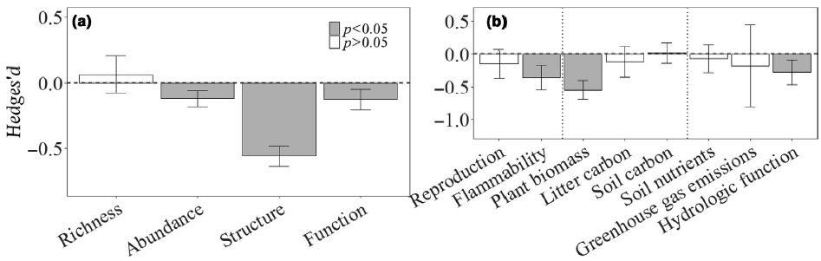
Notes:
In ecology, species richness refers to the number of different species in a community, while species abundance refers to the number of individuals of each species in that community

Slide 19
Notes:
In ecology, species richness refers to the number of different species in a community, while species abundance refers to the number of individuals of each species in that community

Slide 20
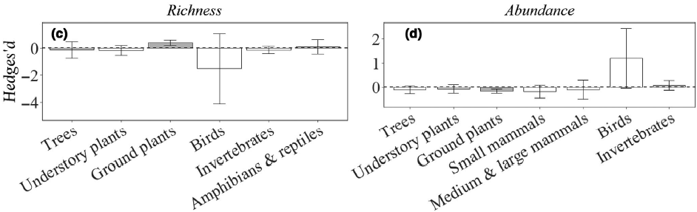






Notes:
In ecology, species richness refers to the number of different species in a community, while species abundance refers to the number of individuals of each species in that community

Slide 21
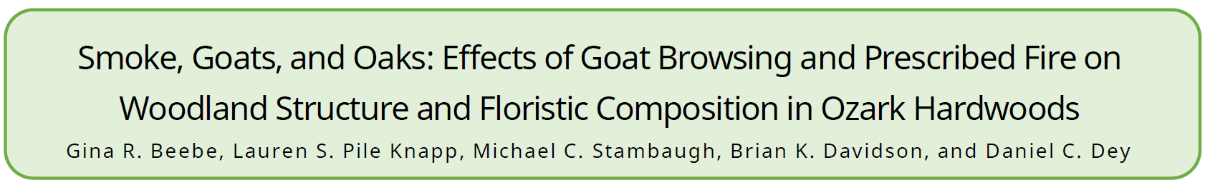
Six treatments
Browsing increased percent cover of grass and forbs
Forb cover increased with burn
Trees > 1 m tall declined with fire and fire + browse
Trees <10 cm were not browsed
Oaks and hickories were less browsed than other trees
Notes:
Six treatments: spring browse, fall browse, spring + fall browse, dormant burn, spring browse + dormant burn, and control. Browsing was completed by “mob grazing” goats until 85% of all veg was browsed

Slide 22
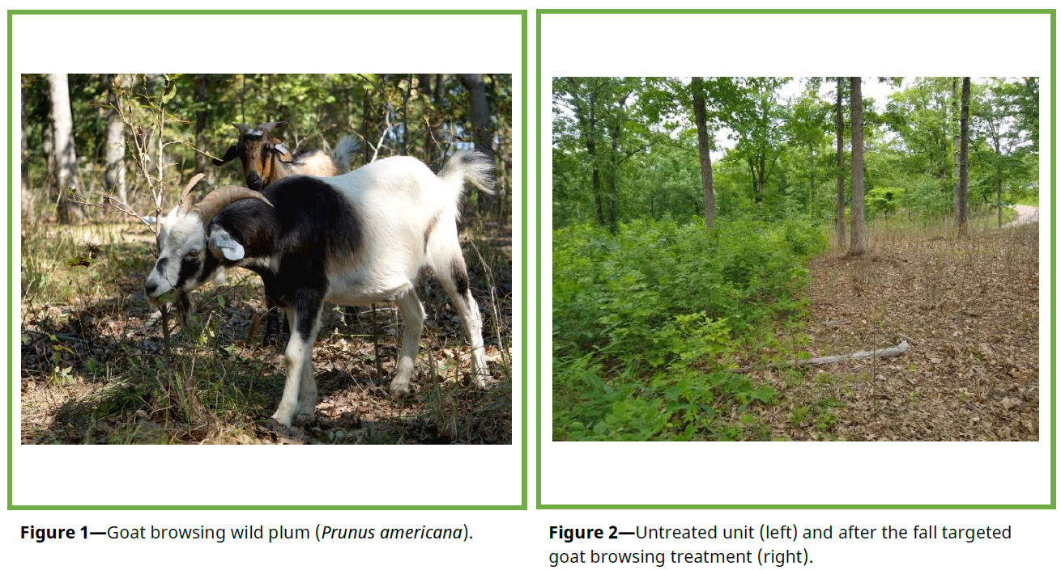

Slide 23
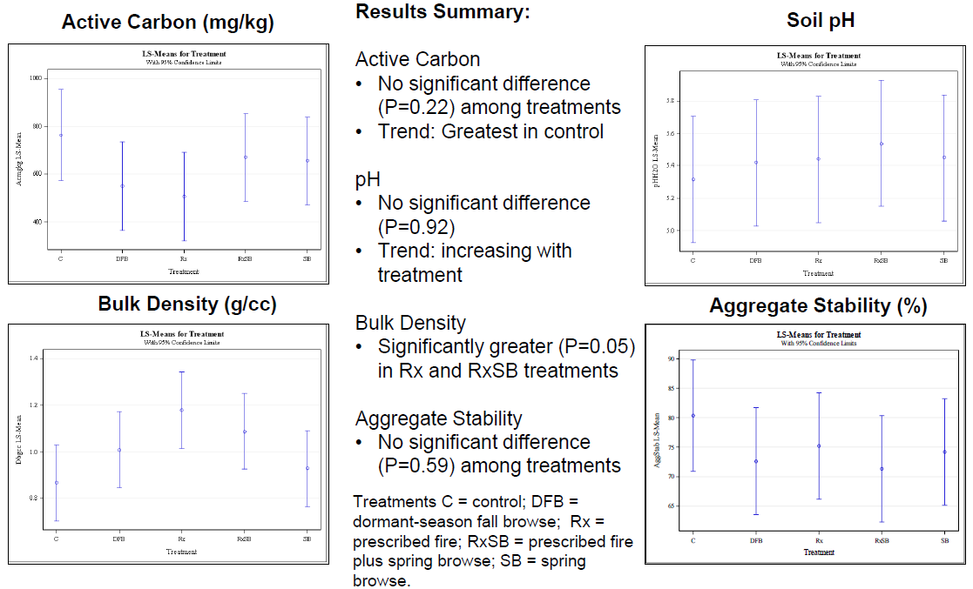
Notes:
Soils data collected and analyzed by Dr John Kabrick, USFS Northern Exp Stn, from Gina Beebe’s targeted grazing study

Slide 24









Notes:
Soils data collected and analyzed by Dr John Kabrick, USFS Northern Exp Stn, from Gina Beebe’s targeted grazing study

Slide 25
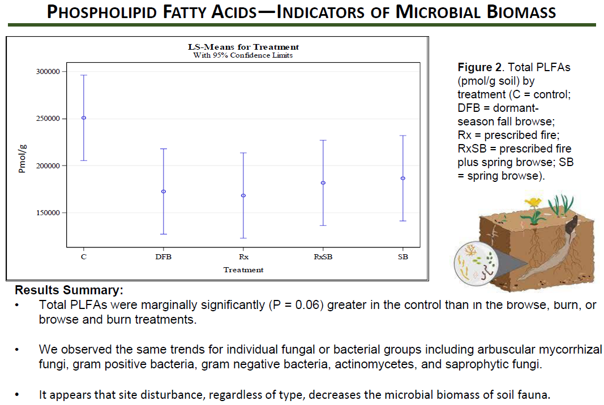
Notes:
Soils data collected and analyzed by Dr John Kabrick, USFS Northern Exp Stn, from Gina Beebe’s targeted grazing study

Slide 26

Notes:
Soils data collected and analyzed by Dr John Kabrick, USFS Northern Exp Stn, from Gina Beebe’s targeted grazing study

Slide 27
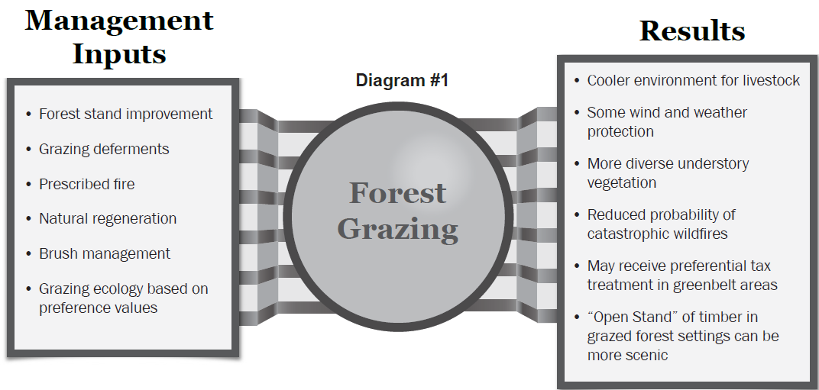
Notes:
“Forest Grazing (as depicted in Diagram #1) is based on the ecological principles that drive a natural system to move toward or maintain a desired ecological site. … The desired plants are only grazed to the degree that still allows for them to have the desired dominance level in the plant community. Forage preference values are currently derived from manager’s experience, the USDA Ecological Site Information System (for some sites), or extension service experience and documentation.”
To summarize, livestock are being used as a tool to manage a plant community; livestock production is not primary purpose.

Slide 28
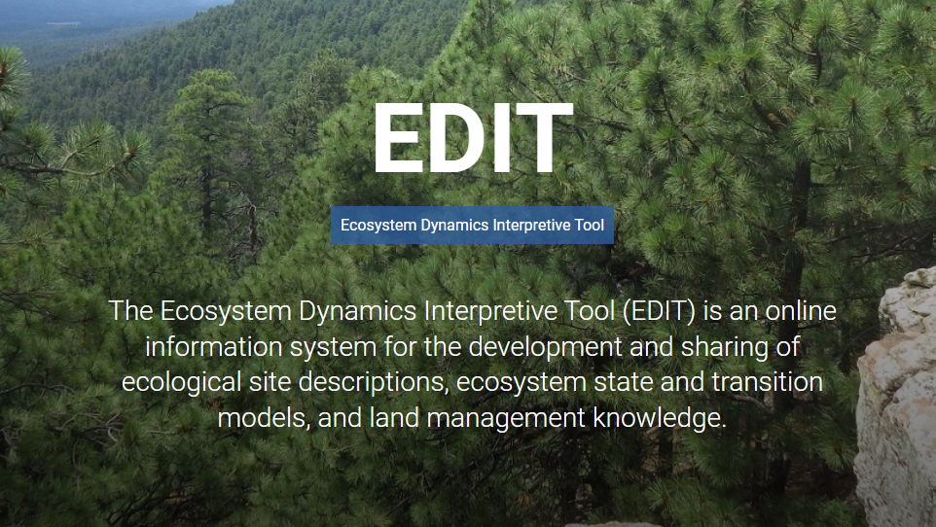

Slide 29
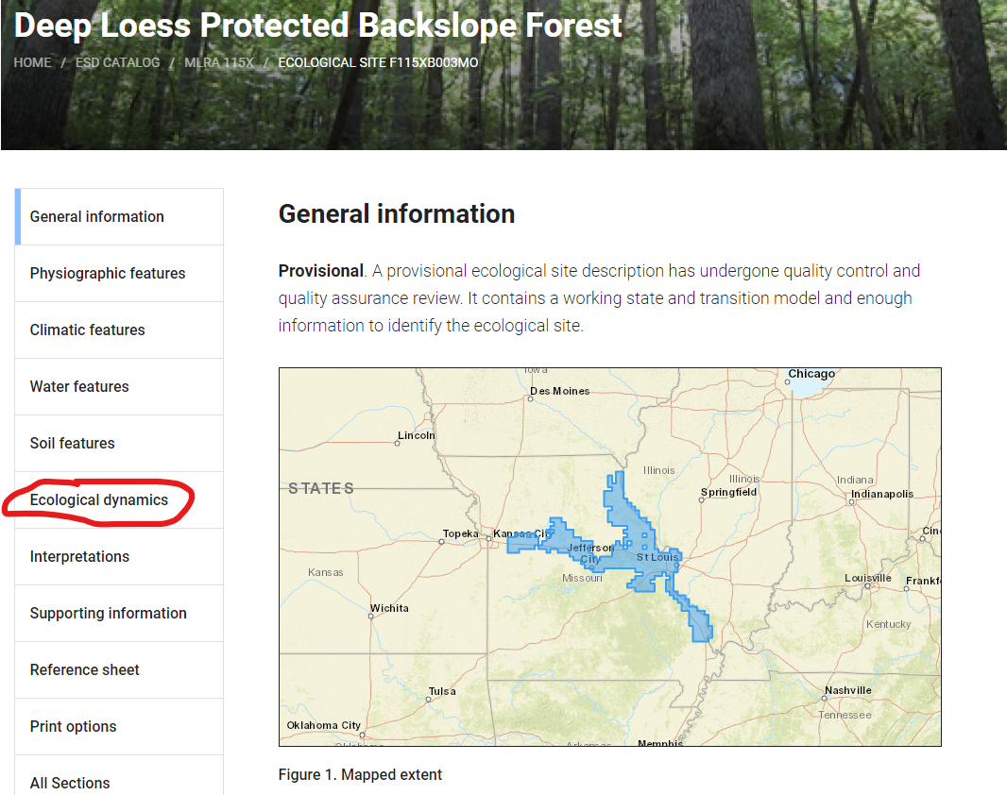
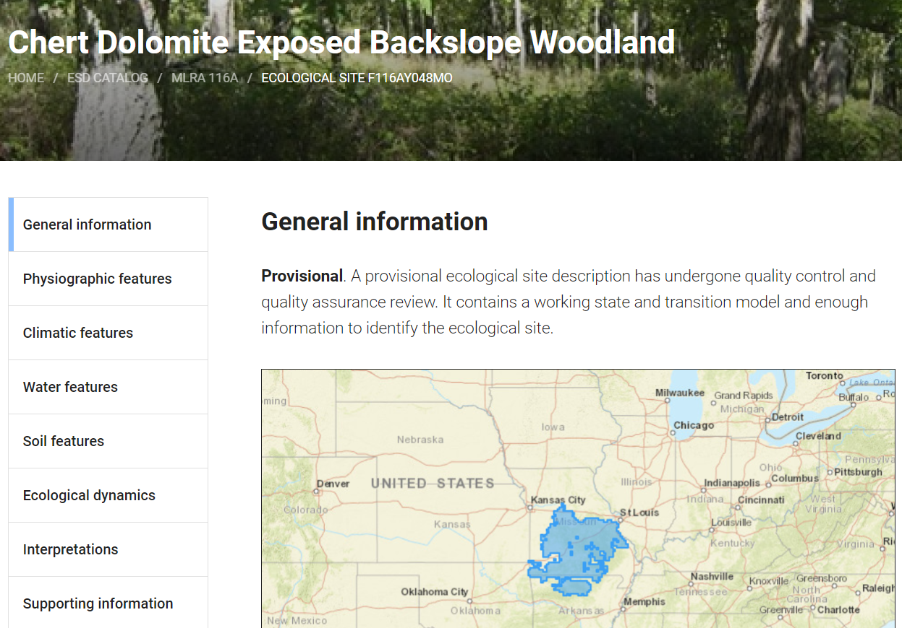

Slide 30
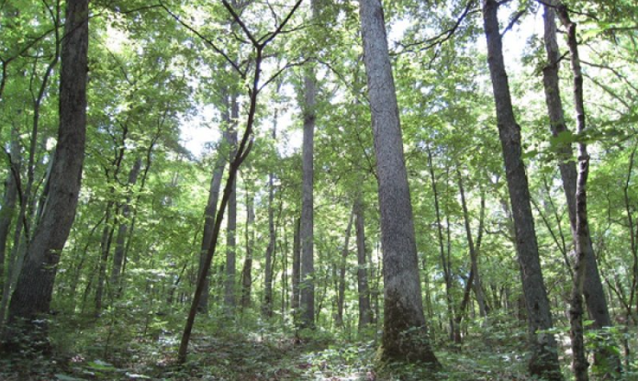
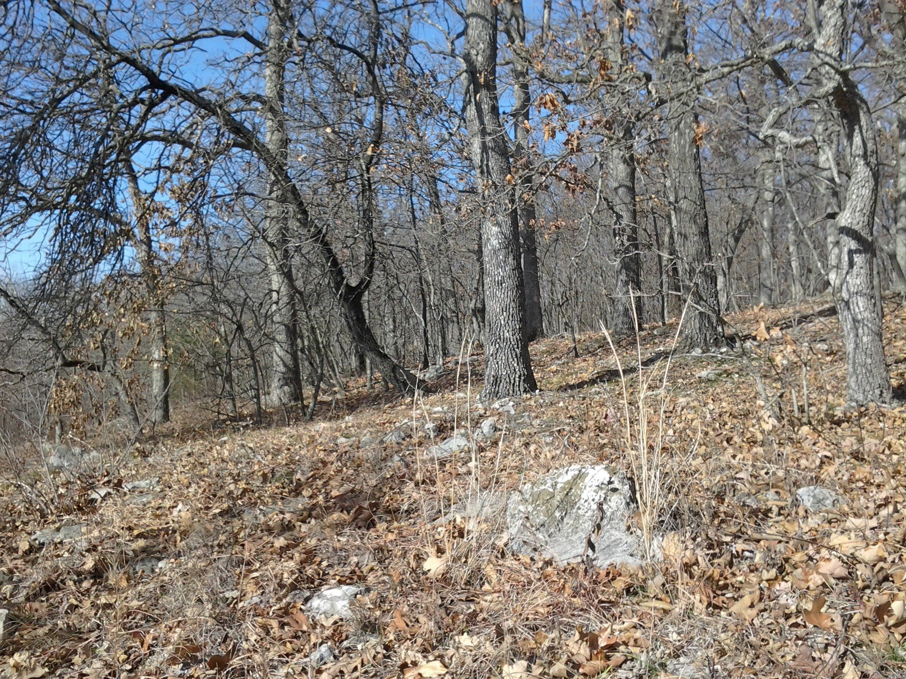
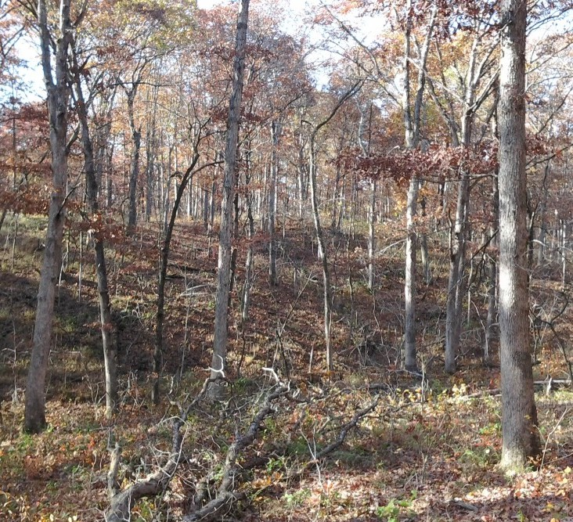
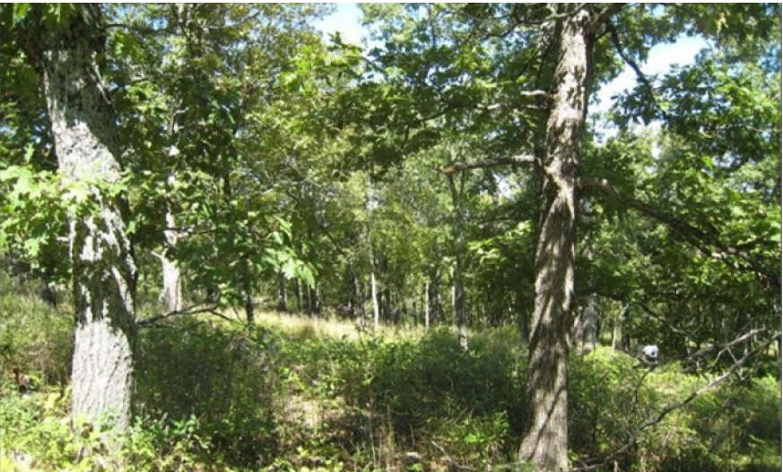

Slide 31
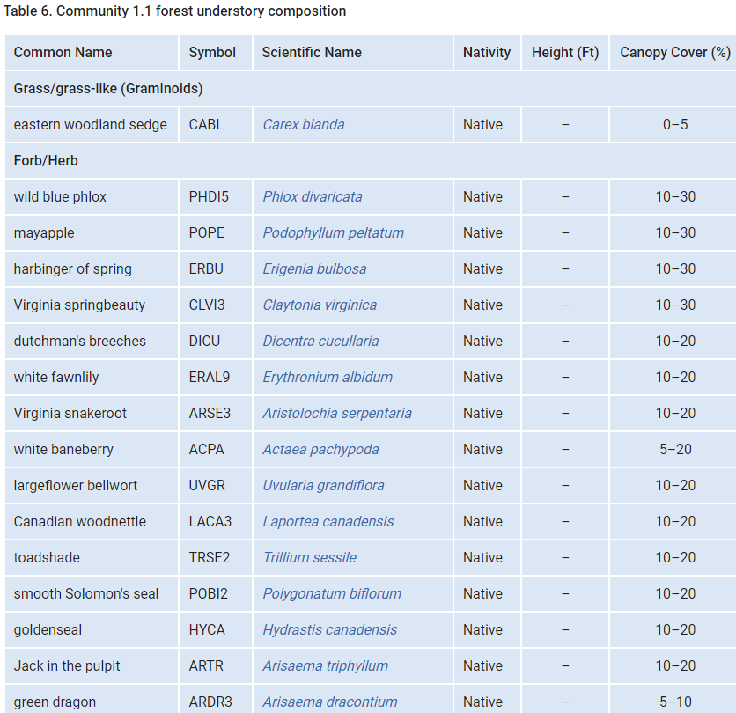
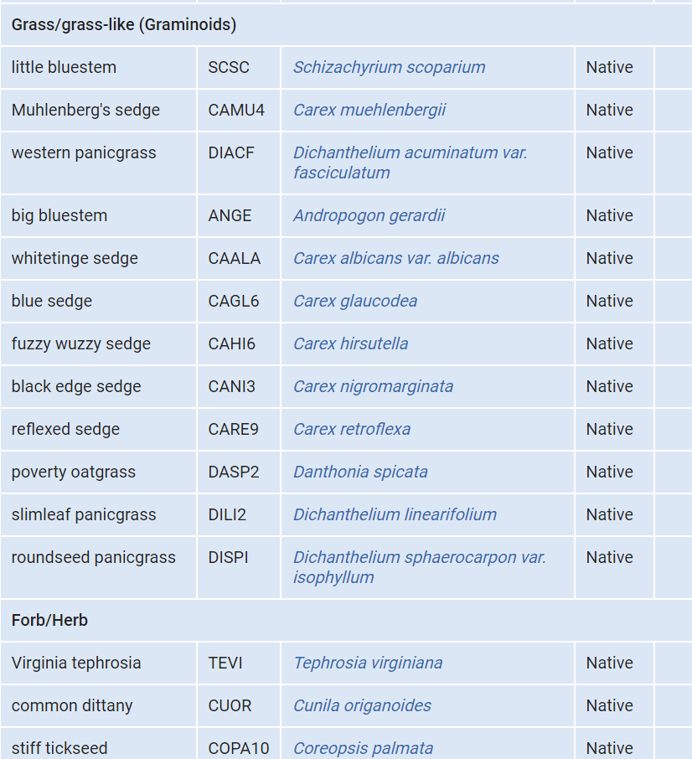

Slide 32
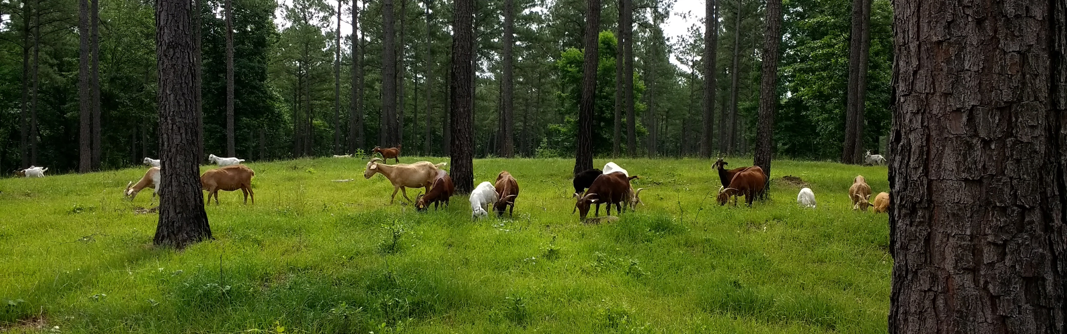
Silvopasture - 381
Establishment and/or management of desired trees and forages on the same land unit.
Notes:
An intentional, integrated system. Is not opportunistic.

Slide 33
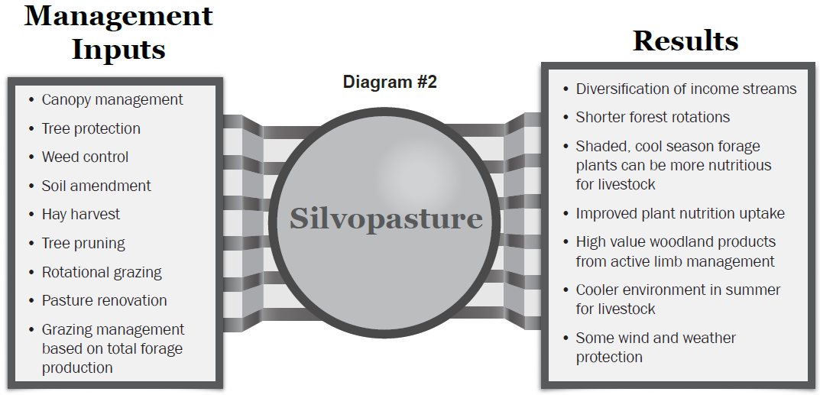
Notes:
“Silvopasture management (as depicted in Diagram #2) is based on the agronomic and forestry principles used to profitably produce and harvest forage and forest products, guided by the limitations and potential of the land. … Tree species are selected that have an economic potential and meet forage light requirements. Forages are selected that thrive in the range of sunlight penetration that is anticipated with the given canopy management. The forest management, pasture management, and grazing management is conducted in harmony, enhancing the production of multiple, harvestable components.”

Slide 34
Forest Soil Health
Soil Cover * Aggregate Stability
Minimize Disturbance * Compaction
Living Roots * Soil Organic Matter
Biodiversity * Soil Organism Habitat
Forest Ecosystem Health * Plant Structure and Composition
Notes:
Image source: https://kaiserscience.wordpress.com/earth-science/surface-processes/soil-profile/
To briefly review, our FSH assessment tool keys in on soil cover, soil disturbance, soil structure/compaction, and living roots. An additional piece to consider is overall forest ecosystem health. Forest farming systems that are part of a healthy forest ecosystem probably exhibit good forest soil health, based on site limitations. Forest farming systems that introduce new plants or that alter the site conditions extensively are likely moving away from healthy forest soils.
The introduction of livestock into an existing forest system can have negative effects on forest soils and forest ecosystems. Let

Slide 35
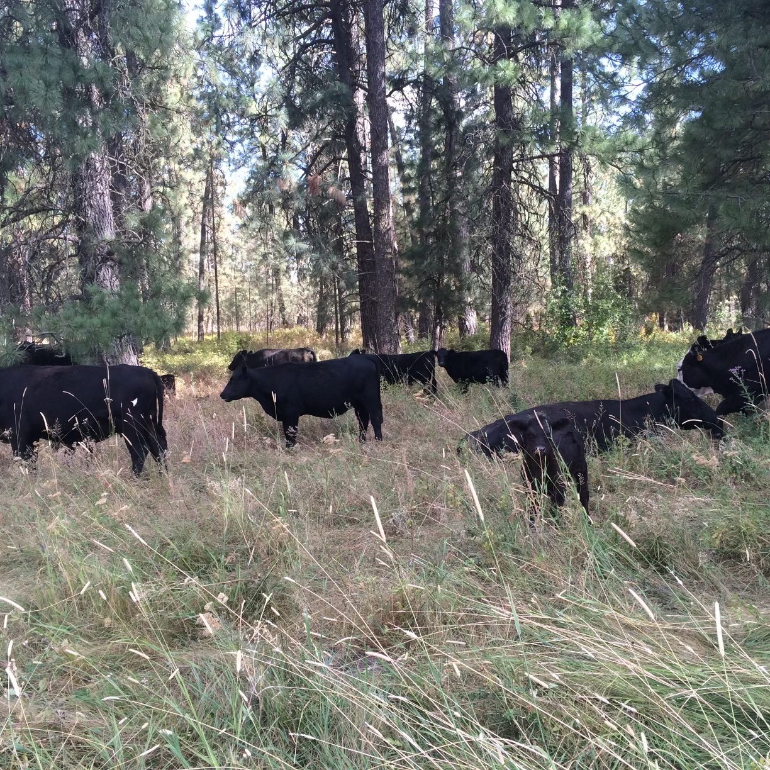
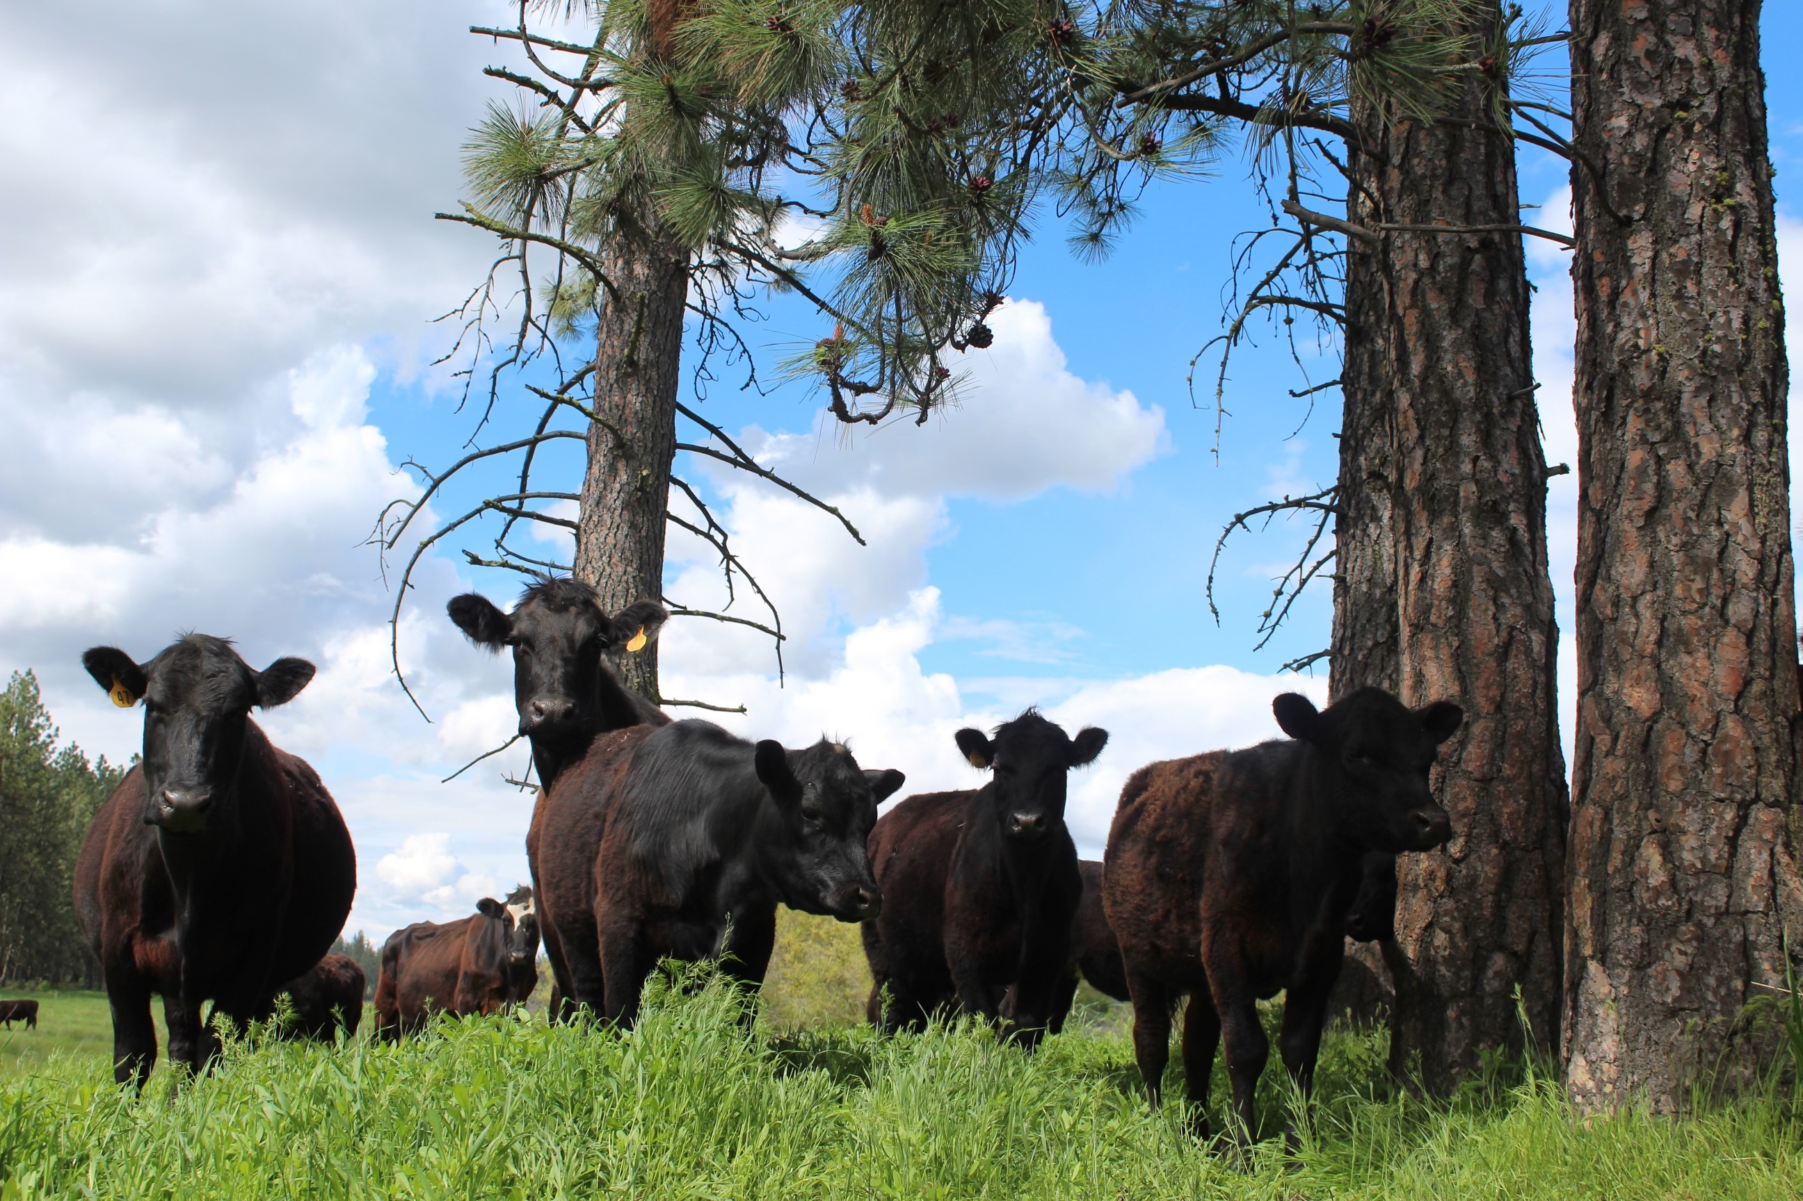
Silvopasture - Examples
Notes:
Here are some good examples of silvopasture in the Pacific Northwest. These are natural stands that have been managed to provide adequate sunlight for forage growth and prescribed grazing is used to manage forage availability.
Mark Batchelor, NAC.

Slide 36
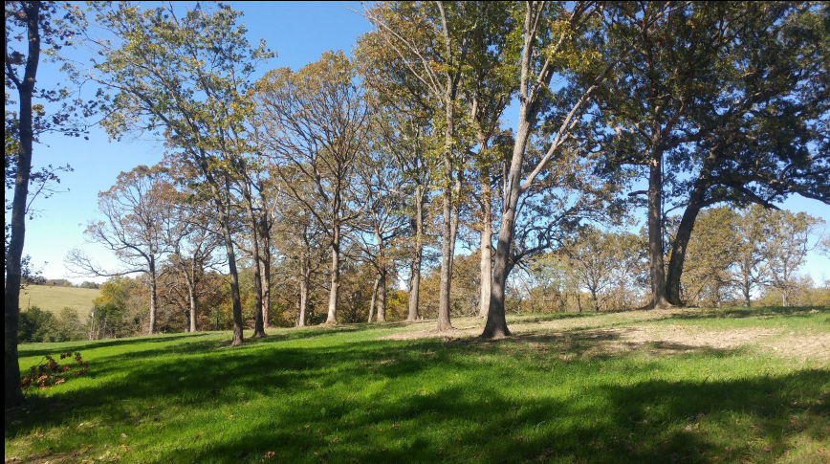
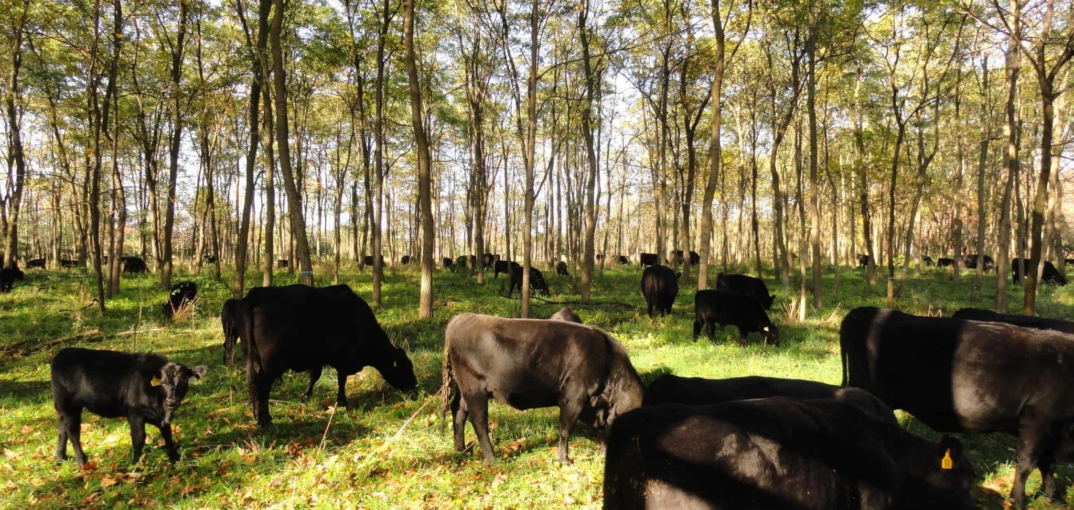
Notes:
Hardwood silvopasture in New York (Brett Chedzoy)

Slide 37
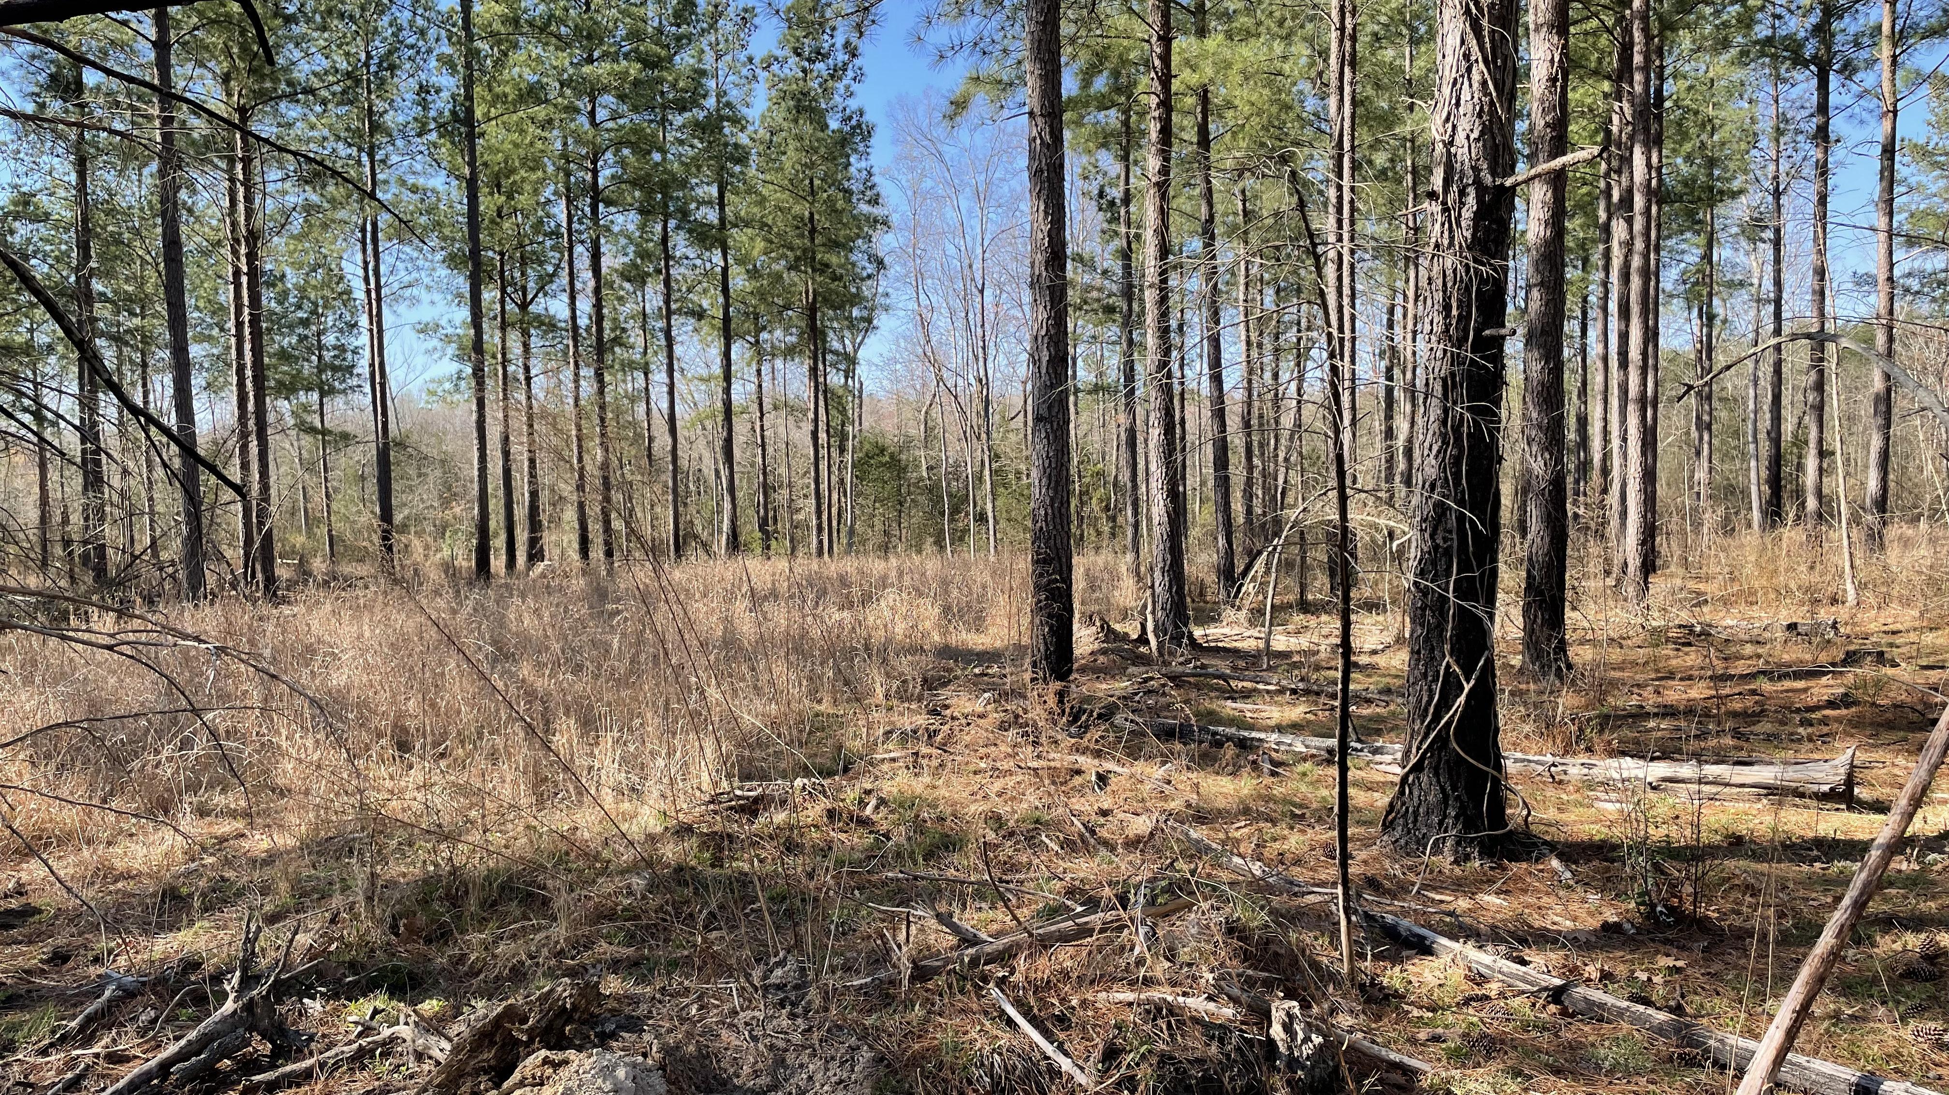
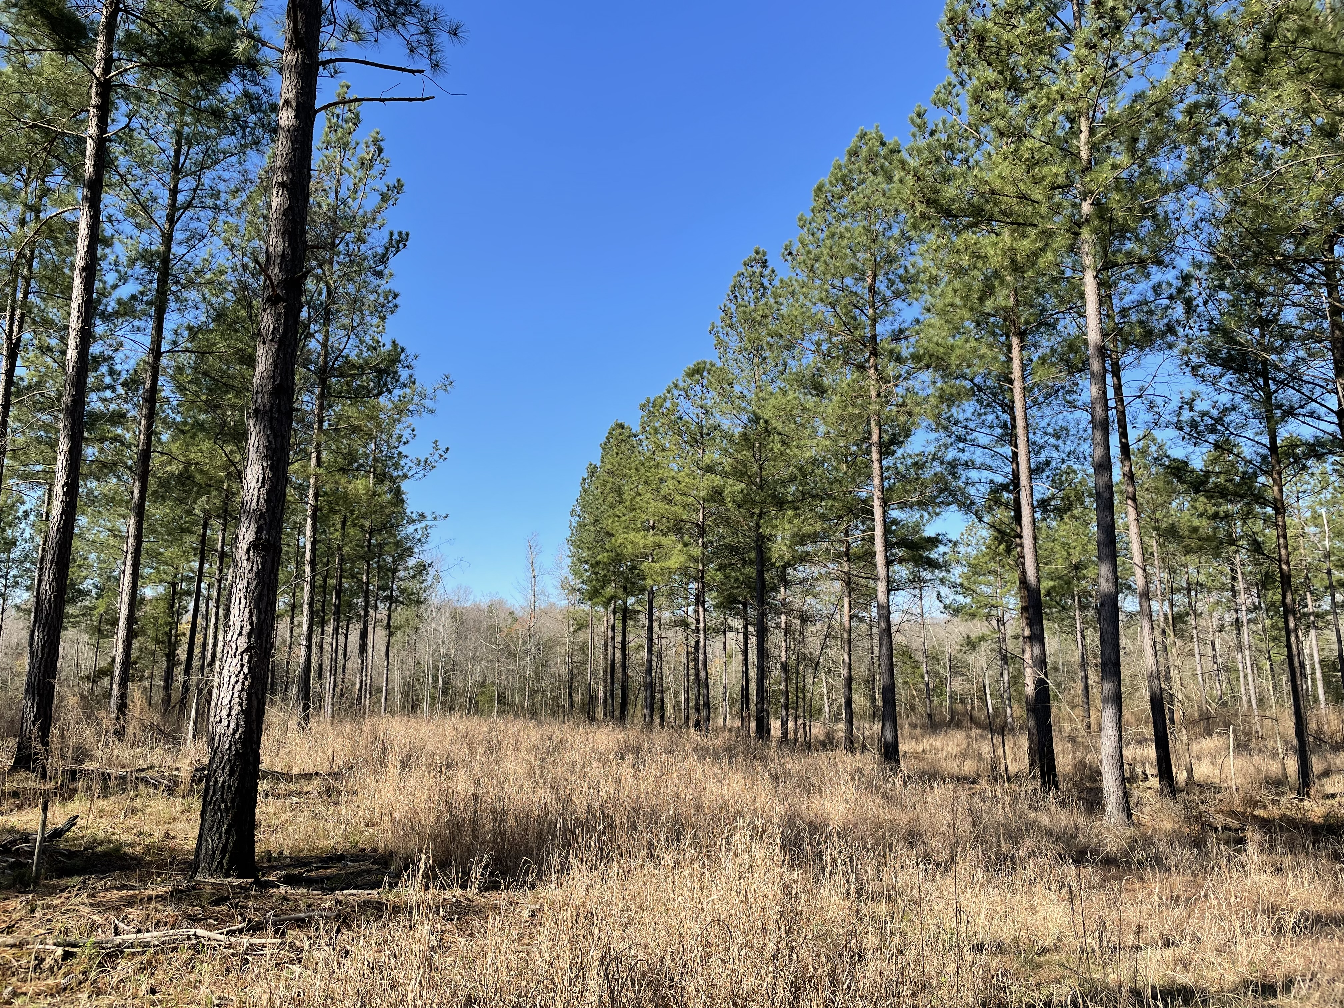

Slide 38
Unpublished, National Agroforestry Center, 2024
Notes:
Scores were based on treatment-level effects. Each significant treatment effect within each research study was scored a value of 1 in the appropriate column, depending on whether it presented a “Positive”, “Negative”, or “None” influence on the Resource Concern. Each research study that was scored may have only one scored line, or several scored lines, depending on the number of treatments in the study that were compared to a Control treatment.
For the Resource Concern “Organic Matter Depletion”:
Positive Influence = 1 when any measure of soil carbon, either by percent (%) or mass (tons per acre) was greater in the silvopasture compared to a Control,
Negative Influence = 1 any measure of soil carbon, either by percent (%) or mass (tons per acre) was lower in the silvopasture compared to a Control
No Influence = 1 when no statistical differences were found between silvopasture and a Control.

Slide 39



Unpublished, National Agroforestry Center, 2024
Notes:
Scores were based on treatment-level effects. Each significant treatment effect within each research study was scored a value of 1 in the appropriate column, depending on whether it presented a “Positive”, “Negative”, or “None” influence on the Resource Concern. Each research study that was scored may have only one scored line, or several scored lines, depending on the number of treatments in the study that were compared to a Control treatment.
For the Resource Concern “Organic Matter Depletion”:
Positive Influence = 1 when any measure of soil carbon, either by percent (%) or mass (tons per acre) was greater in the silvopasture compared to a Control,
Negative Influence = 1 any measure of soil carbon, either by percent (%) or mass (tons per acre) was lower in the silvopasture compared to a Control
No Influence = 1 when no statistical differences were found between silvopasture and a Control.

Slide 40
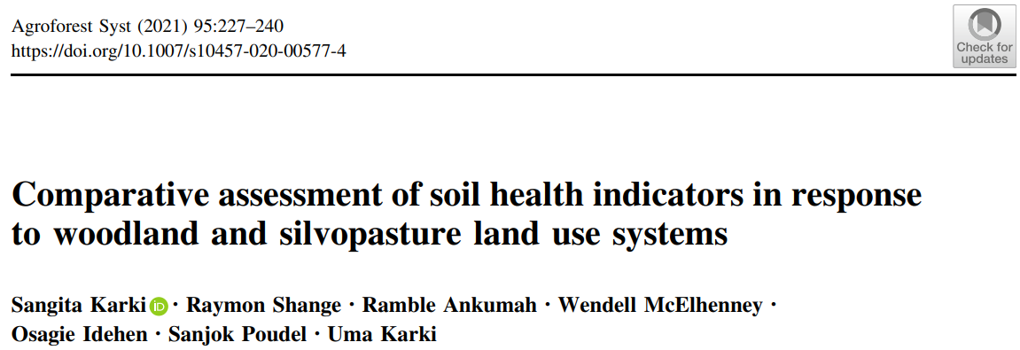
Notes:
The WS was established in 2005 and was mainly dominated by 13-year-old mixed pines: longleaf (Pinus palustris Mill.) and loblolly (Pinus taeda L.)
with some Oaks (Quercus nigra L.; Quercus falcate Michx.), and Sweetgum (Liquidambar L.) as the overstory trees. It also consisted of mid-story vegetation
such as Beautyberry (Callicarpa L.), Muscadine (Vitis rotundifolia Michx.), Yaupons (Ilex vomitoria Aiton), Blackberry (Rubus L.), Greenbrier (Smilax L.), and
some understory species such as Rust weed (Polypremum procumbens L.), Panicgrass (Panicum L.), Blackberry (Rubus L.), Broomsedge (Andropogon
L.), and Dogfennel (Eupatorium capillifolium Lam.) The SPS was established in the summer of 2014 by thinning out the existing woodland to facilitate light
penetration for pasture establishment. Warm-season forages such as Bahiagrass (Paspalum notatum Fluegge´), Crabgrass (Digitaria sanguinalis (L.) Scop.),
and/or Sericea lespedeza (Lespedeza cuneata (Dum.Cours.) G. Don) and cool-season forages such as Rye (Secale cereale L.), Crimson clover (Trifolium incarnatum L.), Marshall ryegrass (Lolium multiflorum L.), Arrowleaf clover (Trifolium vesiculosum Savi.), Chicory (Cichorium intybus L.), MaxQ tall fescue (Festuca

Slide 41
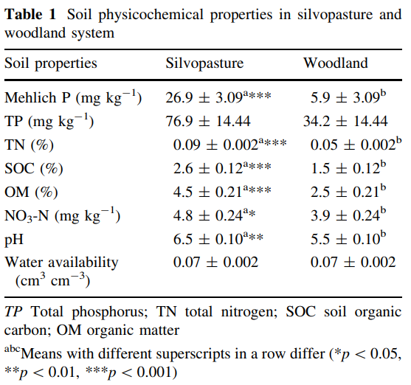
Notes:
The WS was established in 2005 and was mainly dominated by 13-year-old mixed pines: longleaf (Pinus palustris Mill.) and loblolly (Pinus taeda L.)
with some Oaks (Quercus nigra L.; Quercus falcate Michx.), and Sweetgum (Liquidambar L.) as the overstory trees. It also consisted of mid-story vegetation
such as Beautyberry (Callicarpa L.), Muscadine (Vitis rotundifolia Michx.), Yaupons (Ilex vomitoria Aiton), Blackberry (Rubus L.), Greenbrier (Smilax L.), and
some understory species such as Rust weed (Polypremum procumbens L.), Panicgrass (Panicum L.), Blackberry (Rubus L.), Broomsedge (Andropogon
L.), and Dogfennel (Eupatorium capillifolium Lam.) The SPS was established in the summer of 2014 by thinning out the existing woodland to facilitate light
penetration for pasture establishment. Warm-season forages such as Bahiagrass (Paspalum notatum Fluegge´), Crabgrass (Digitaria sanguinalis (L.) Scop.),
and/or Sericea lespedeza (Lespedeza cuneata (Dum.Cours.) G. Don) and cool-season forages such as Rye (Secale cereale L.), Crimson clover (Trifolium incarnatum L.), Marshall ryegrass (Lolium multiflorum L.), Arrowleaf clover (Trifolium vesiculosum Savi.), Chicory (Cichorium intybus L.), MaxQ tall fescue (Festuca

Slide 42
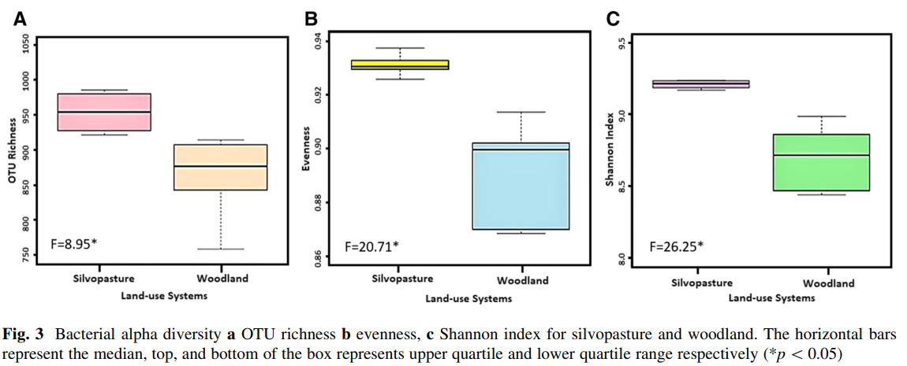

Slide 43
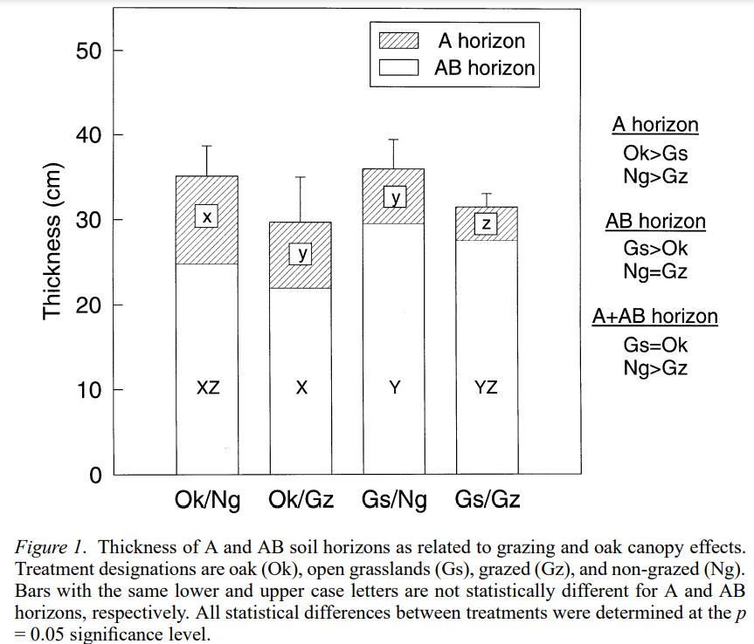
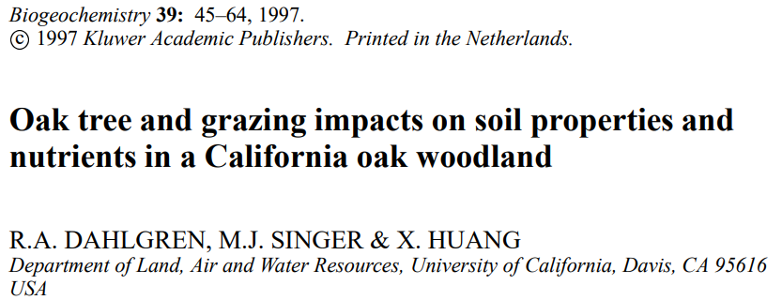

Slide 44
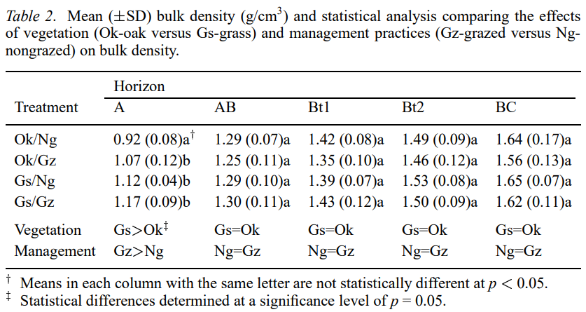

Slide 45
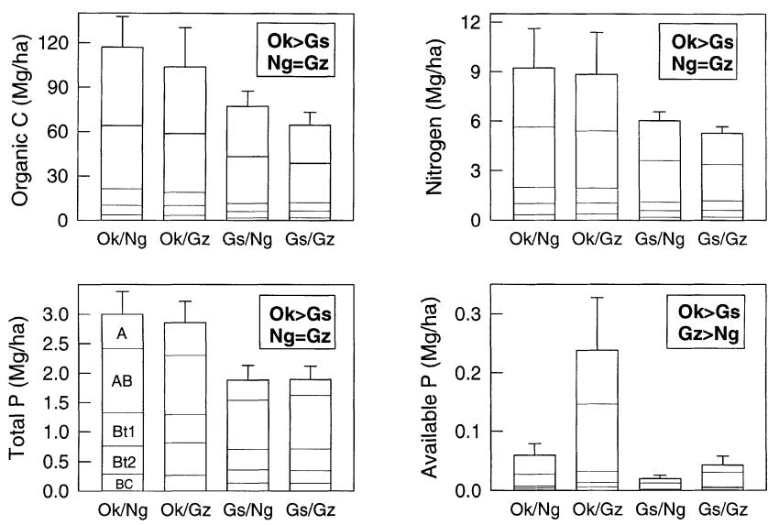
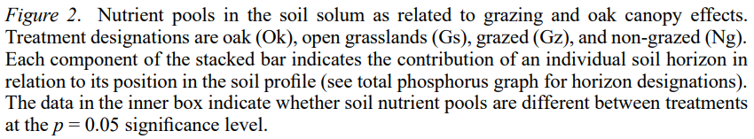

Slide 46
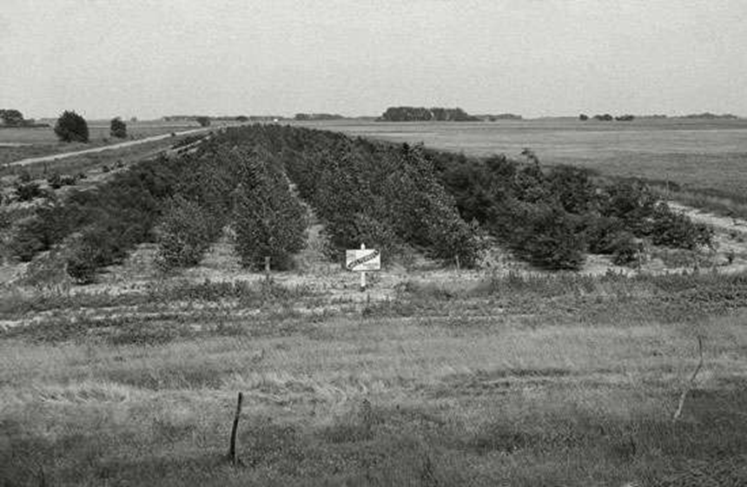
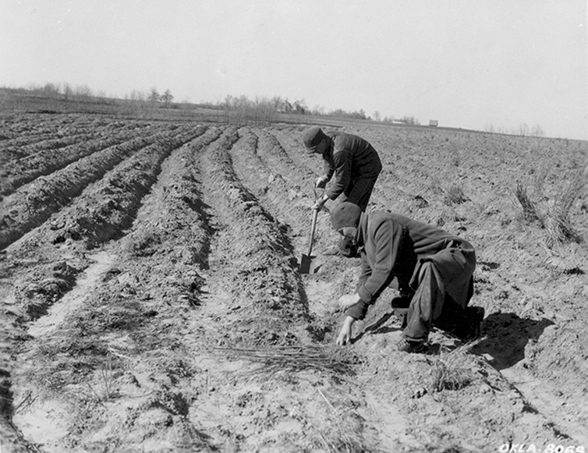
joe.alley@usda.gov

Slide 47
Thank you!
For more information on Managing Soil Health,
visit us here:
https://www.nrcs.usda.gov/conservation-basics/natural-resource-concerns/soils/soil-health
USDA is an equal opportunity provider, employer, and lender.

